Slide 1
ADVANCED MESH HACK TRICKS
Society of Hackers / 2026 May 6
Prepared by Danielle McGuire and Greyfox for the May 2026 session of the Society of Hackers

Slide 2
Radio Measurement and Hardware Fabrication
Danielle McGuire

Slide 3
Meshtastic is a platform for encrypted off-grid messaging utilizing the LoRa protocol in an ISM band (US: 915 MHz).
What does that even mean?

Slide 4
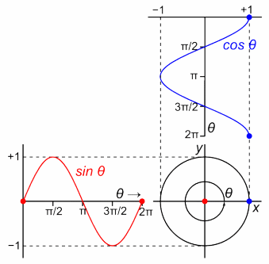
DEMO - Fundamentals of Radio Waves
If you want to find the secrets of the universe, think in terms of energy, frequency and vibration. Nikola Tesla
Using VCVRack, demonstrate wave amplitude, frequency, wavelength, waveshape, and modulation
If that don’t work - https://www.codeitbro.com/tool/sine-wave-generator

Slide 5
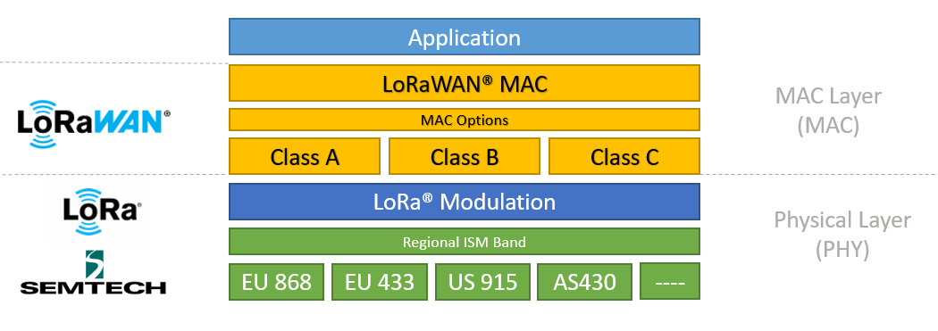
LoRa Protocol
Image Credits: Semtech. Semtech makes the SX1262 chip which Heltec uses on its LoRa boards
SDR capable of RX/TX over 150-960 MHz, up to +22dBm with integrated power amplifiers
In the diagram above, the Physical Layer corresponds to OSI Layer 1 and the MAC Layer corresponds to OSI Layer 2
LoRaWAN is a centralized star network for connecting LoRa radios to the Internet (similar to Zigbee)
LoRa does not implement device authentication, and neither does Meshtastic.

Slide 6
DEMO - Dissecting the LoRa Protocol with an RTL-SDR
Postponed for future presentation
Using an RTL-SDR, capture communications between two Meshtastic nodes over the unencrypted LongFast channel, then decode that data using GNU-Radio to recover the payload https://github.com/tapparelj/gr-lora_sdr

Slide 7
Radio, like all STEM fields, is all about measurement.
The measurements we care about used to require tools that cost $10K-30K total; today, they cost less than $200.

Slide 8
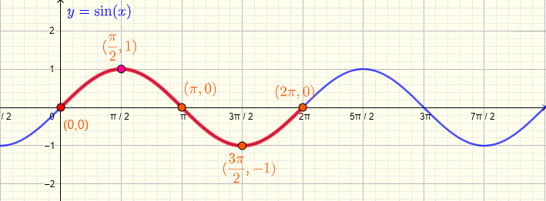
What Are We Measuring?
On a 2D graph, the domain is the horizontal x-axis, and the codomain is the vertical y-axis, while the range is the set of all values the function takes.
Here, the domain is all real numbers, the codomain is all real numbers, and the range is all real numbers between -1 and 1.
COMMON MEASUREMENT DOMAINS:
Time Domain (Oscilloscope)
Frequency Domain (TinySA, NanoVNA)
COMMON MEASUREMENTS:
Signal amplitude (Oscilloscope, TinySA)
Complex Impedance (NanoVNA)
Parameter Domains (NanoVNA)
  S-Parameter Family
    Standing Wave Ratio (SWR)
  Z-Parameter Family
And more! (other equipment)
  H-, T-, ABCD-Parameter Families

Slide 9
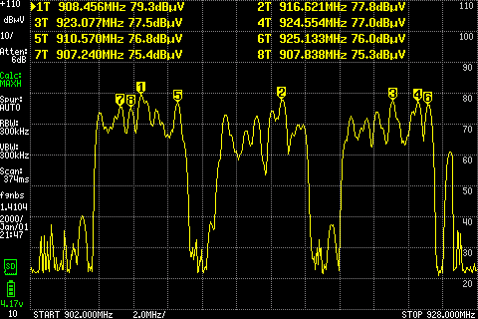
TinySA Measurements - Spectrum Readings
Frequency-domain signal amplitude measurements
AKA “Frequency on x-axis, Signal Strength on y-”
Lets us “see” the signal as it passes by*
*sampling rate can warp results
$63 standard (0.1-960 MHz), $183 Ultra (0.1-7000 MHz) on AliExpress
Also need protection equipment (SoH provides access to
10W attenuator ($25 10W 20db 6G* unit),
*6G means “DC (0 Hz) to 6 GHz input range”
Set 2W attenuators ($45 2W 1-20db 8G 6pc set)
RF filter ($78 VLM-33W-2W-S unit))
Or you can use an $38 RTL-SDR as a 24-1700 MHz Spectrum Analyzer! Check out Paul Maine’s tutorial
From TestMeasurementTips.com: Radiated emissions in the 915 MHz ISM band at a nearby drug store to the gas station price sign. The analyzer was placed in Max Hold mode, and a short 900 MHz antenna was used. The TinySA Ultra was placed in my shirt pocket while walking throughout the store for a few minutes to build up a composite spectral plot. This corresponded to the interference received at the gas station.
Notes:
Forum thread reccing RF filter https://groups.io/g/tinysa/topic/106483465#msg17520

Slide 10
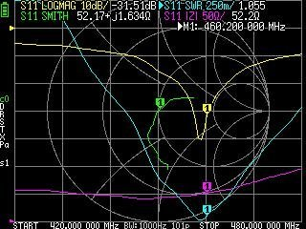
NanoVNA Measurements
Capable of showing multiple measurement domains at once
Freq Domain, plotted on Smith Chart
  “Smith” (green trace) - Complex Impedance
Freq Domain, plotted on Cartesian axes
  “LogMag” (yellow trace) - Attenuation
  “SWR” (blue trace) - Standing Wave Ratio
  “|Z|” (purple trace) - Impedance Magnitude
We care most about SWR and Impedance matching
Let’s look at each separately and explain what those big words mean
Photo from dosw’s post on forums.mygmrs.com measuring $75 MXTA26 antenna for GMRS (462-467 MHz) (min SWR at 465 MHz)
Notes:
Forum thread reccing RF filter https://groups.io/g/tinysa/topic/106483465#msg17520

Slide 11
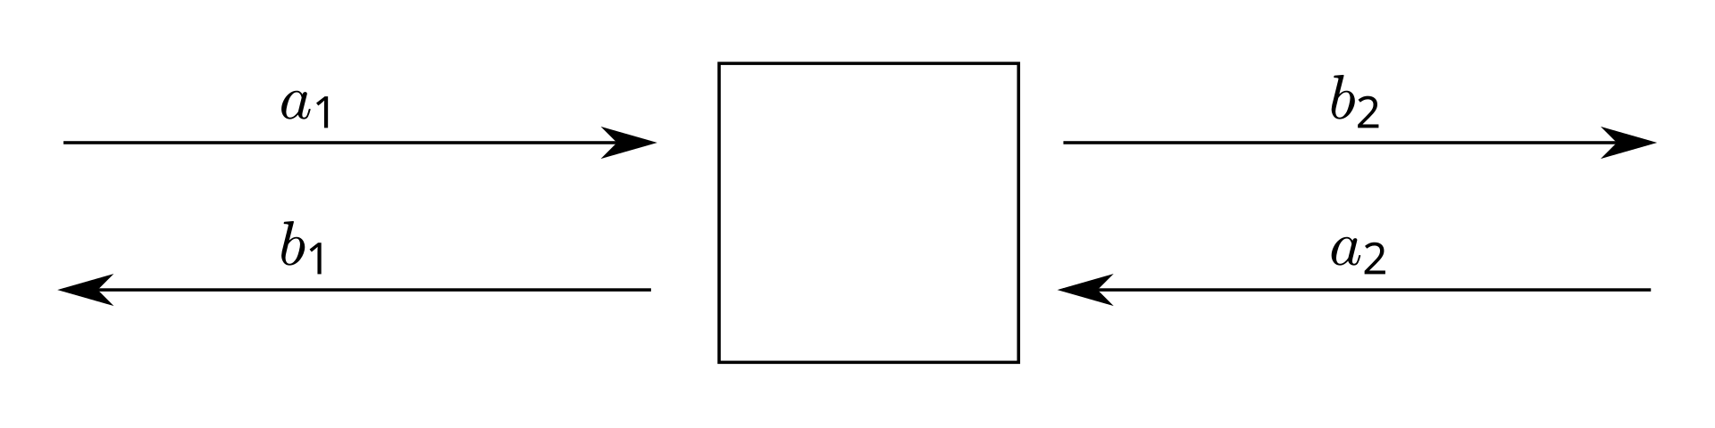
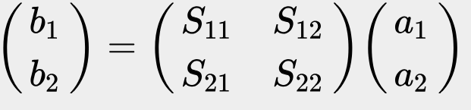
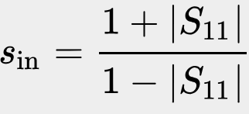
NanoVNA Measurements - s-parameters Theory
Top left: diagram of 2-port network
Component with two wires (resistor, capacitor, diode, antenna, etc)
Middle left: scattering parameter matrix equation relating inputs (a) to outputs (b) at each port (1 and 2)
Ignore the equations if they make no sense
Bottom left: s_{in} is SWR, standing wave ratio
Also called voltage standing wave ratio, or VSWR
Ratio of max voltage to min voltage on the antenna
  1 is perfect
  <1.1 is excellent for an antenna
  <1.6 is typical for a <$5 antenna
  >=2 is a terrible antenna
Photo credit: Wikipedia
Notes:
Forum thread reccing RF filter https://groups.io/g/tinysa/topic/106483465#msg17520

Slide 12
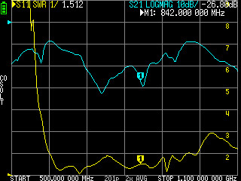
NanoVNA Measurements - SWR Matching
Just need to know the SWR value at desired freq, and the freq at which SWR is minimum
Can tune SWR on some antennas by clipping off small pieces until min SWR freq is desired RX/TX freq
In other words - just read a graph!
Photo credit: Kerry Wong, "Teardown of a LiteVNA Vector Network Analyzer" (The LiteVNA project forked off NanoVNA, this screen looks the same on NanoVNA)
Notes:
Forum thread reccing RF filter https://groups.io/g/tinysa/topic/106483465#msg17520

Slide 13
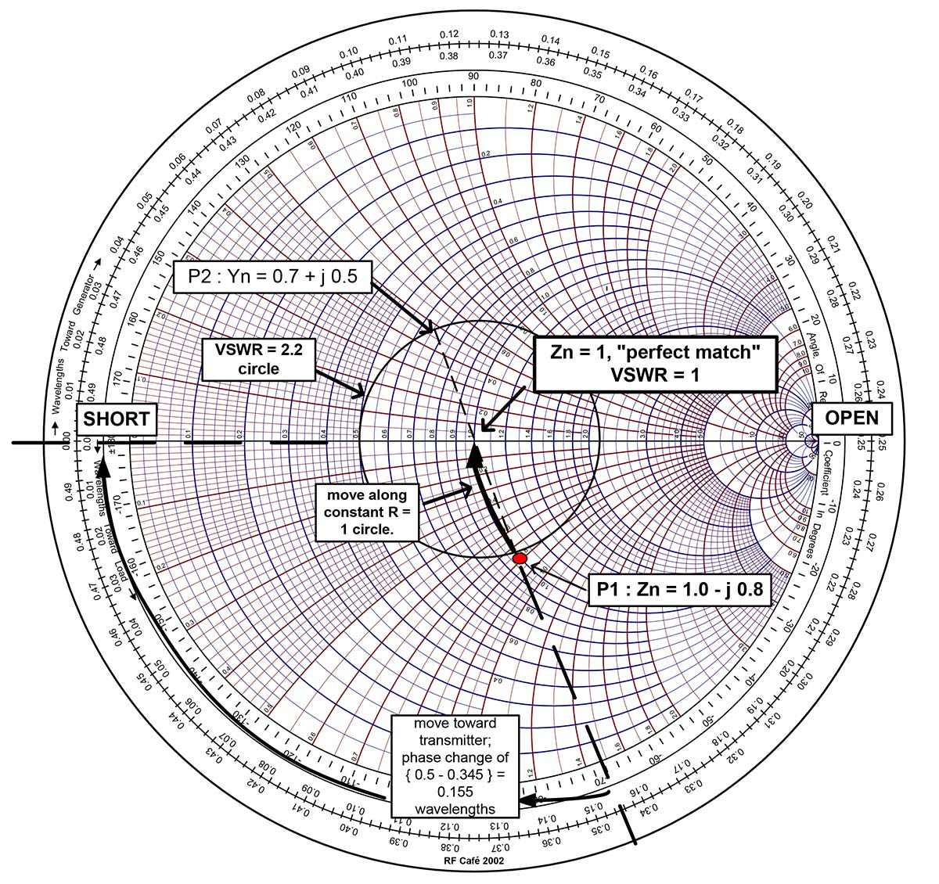
NanoVNA Measurements - Smith Chart Theory
Smith Chart - alternative to Cartesian graph (x and y axis) for plotting complex impedance values over freq domain
More counterintuitive at first, but turns tricky algebraic calculations into easy geometric observations
  Far left on center horizontal axis is short (zero imp.)
  Far right is open (infinite imp.)
  Dead center is 50ohm (radio standard)
Going up adds capacitance (positive imaginary)
Going down adds inductance (negative imaginary)
When impedance matching antenna, want impedance graph to be physically closest to center at operating freq
Alternate side of circle (see P2 compared to P1) gives impedance to add to antenna circuit to get to 50ohm total
Photo credit: Jude Misaid
Notes:
Forum thread reccing RF filter https://groups.io/g/tinysa/topic/106483465#msg17520

Slide 14
NanoVNA Measurements - Reading the Full Graph
Look at each line separately and understand its domain
Same freq at same marker (we have 1 here)
Smith chart is separate from Cartesian axes
Remember:
Need to calibrate for each measurement range (can save 5-7 calibrations depending on model)
All these values change based on antenna position/orientation, surrounding objects, and atmospheric conditions
Photo from dosw’s post on forums.mygmrs.com measuring $75 MXTA26 antenna for GMRS (462-467 MHz) (min SWR at 465 MHz)
Notes:
Forum thread reccing RF filter https://groups.io/g/tinysa/topic/106483465#msg17520

Slide 15
LoRa Mesh Nodes need 4 parts:
LoRa Chipsets,
LoRa Antennas,
Power Supply, and
Cases

Slide 16
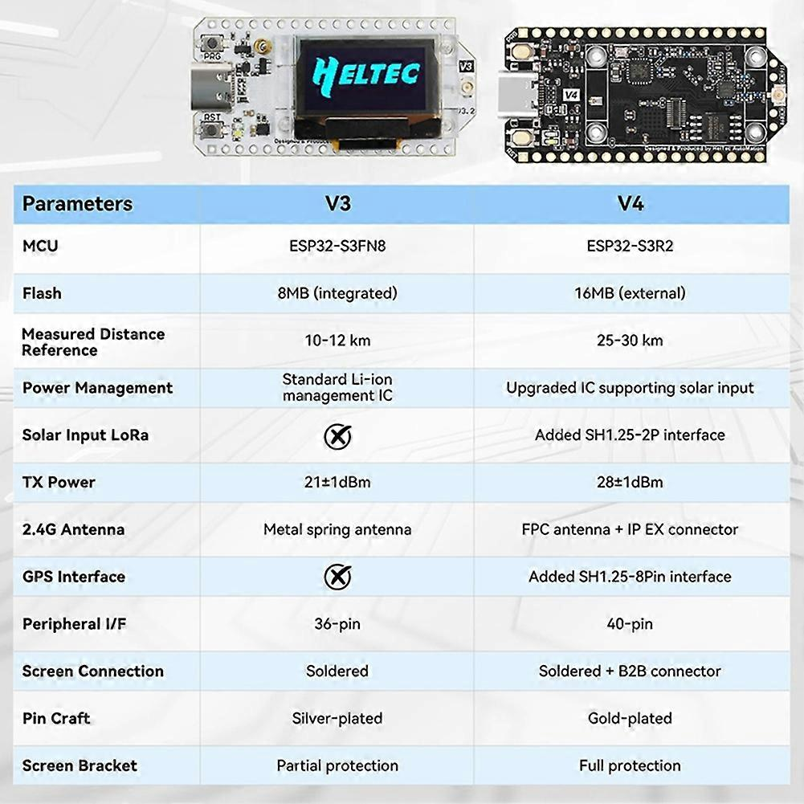
Chipset - Heltec ESP32
Society of Hackers / 2026 May 6
V3 ($18)- ESP32S3-FN8 MCU (Wifi, Bluetooth) and Semtech SX1262 LoRa Node chip (LoRa), with USB-C and CP2102 USB-to-serial chip
V4 ($20) - All that, but upgraded ESP32S3-S3R2 MCU, 4x TX power, built-in solar charge controller, and much nicer GUI, with identical pinout. S3R2 USB-OTG feature means no need for C2102, lowering power consumption
Having Wifi Access and a GUI screen is very convenient for end users, but burns the battery much faster
Ideal for handheld mobile nodes

Slide 17
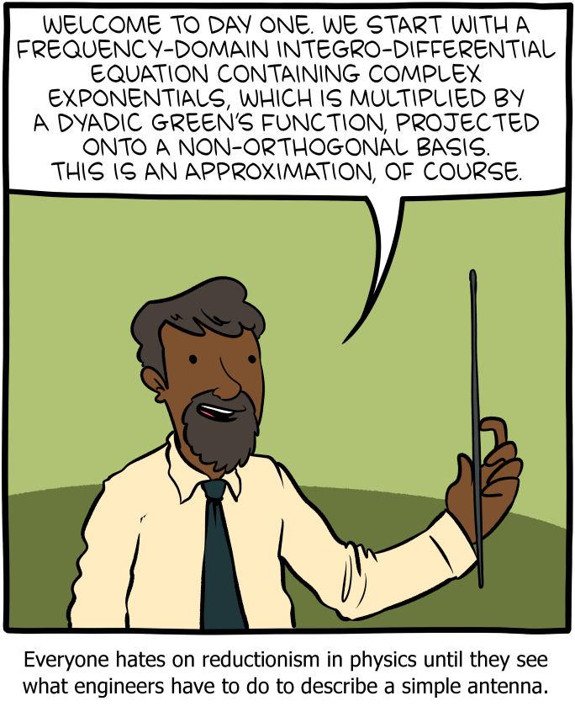
Antennas - Build Your Own!
Easy - Steven’s Stinger Gen2
Tricky - Steven’s Stinger Gen3
Eldritch and Abominable - Design Your Own
have fun doing ANTENNA MATH, dummy
To make a decent antenna, very carefully cut pieces to the length given in a design, or determined by a good antenna calculator
To make a great antenna, measure that with a VNA, and snip tiny pieces off of elements until resonant frequency and impedance are as perfect as possible

Slide 18
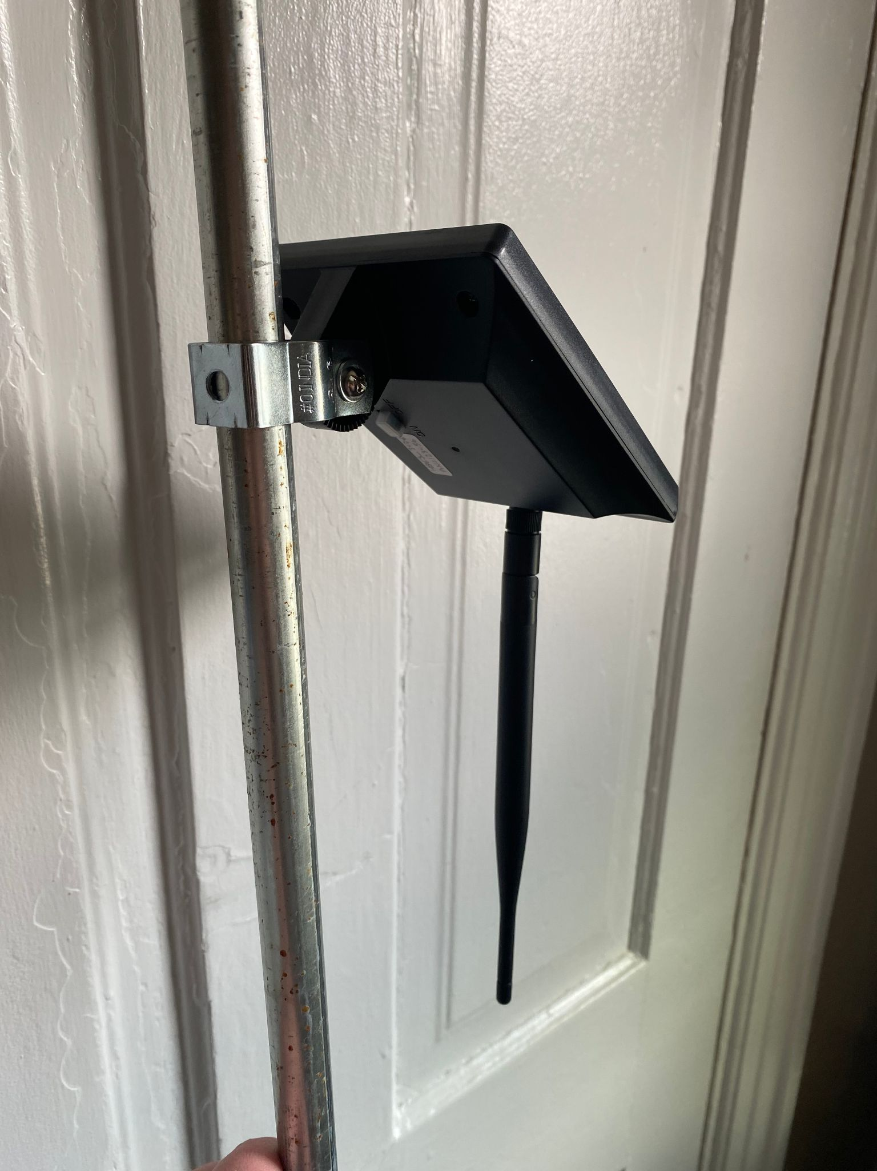
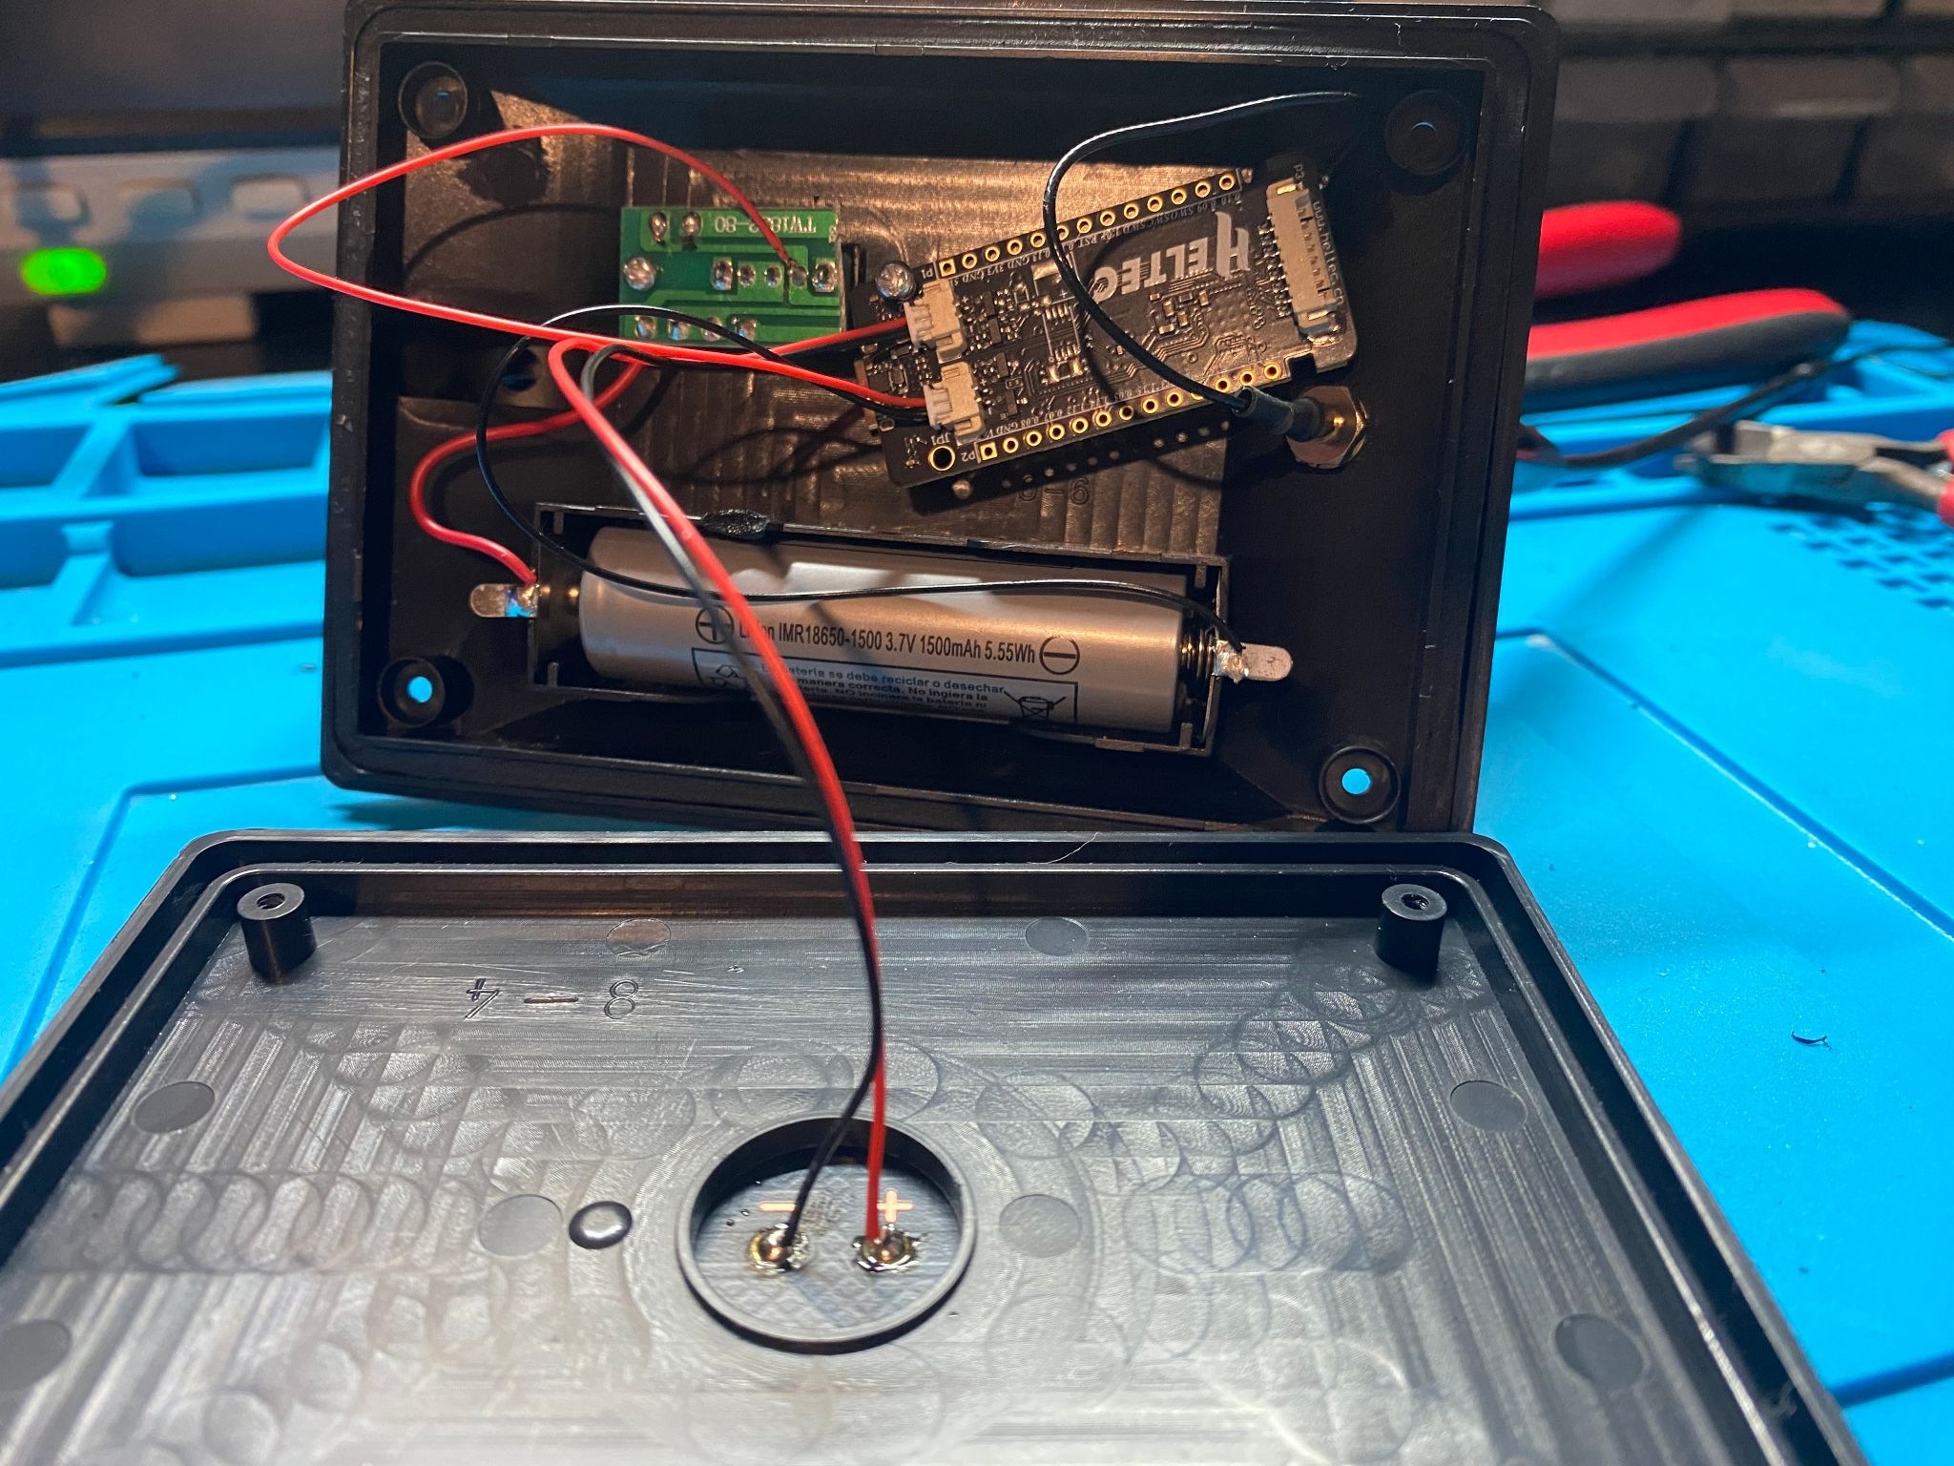
Power Supply and Case - Stationary Solar Node
HACKERSBLOOMv1
$30 components
Lowe’s 1W Harbor Breeze solar light
Heltec T114
GT-800 antenna
MUST be positioned where solar panel gets max sun!!
Antennas should be vertical for best reception

Slide 19
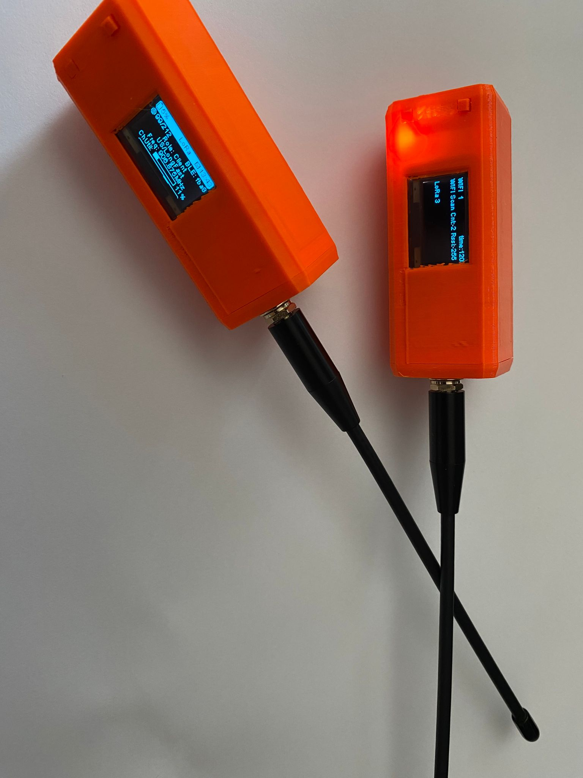
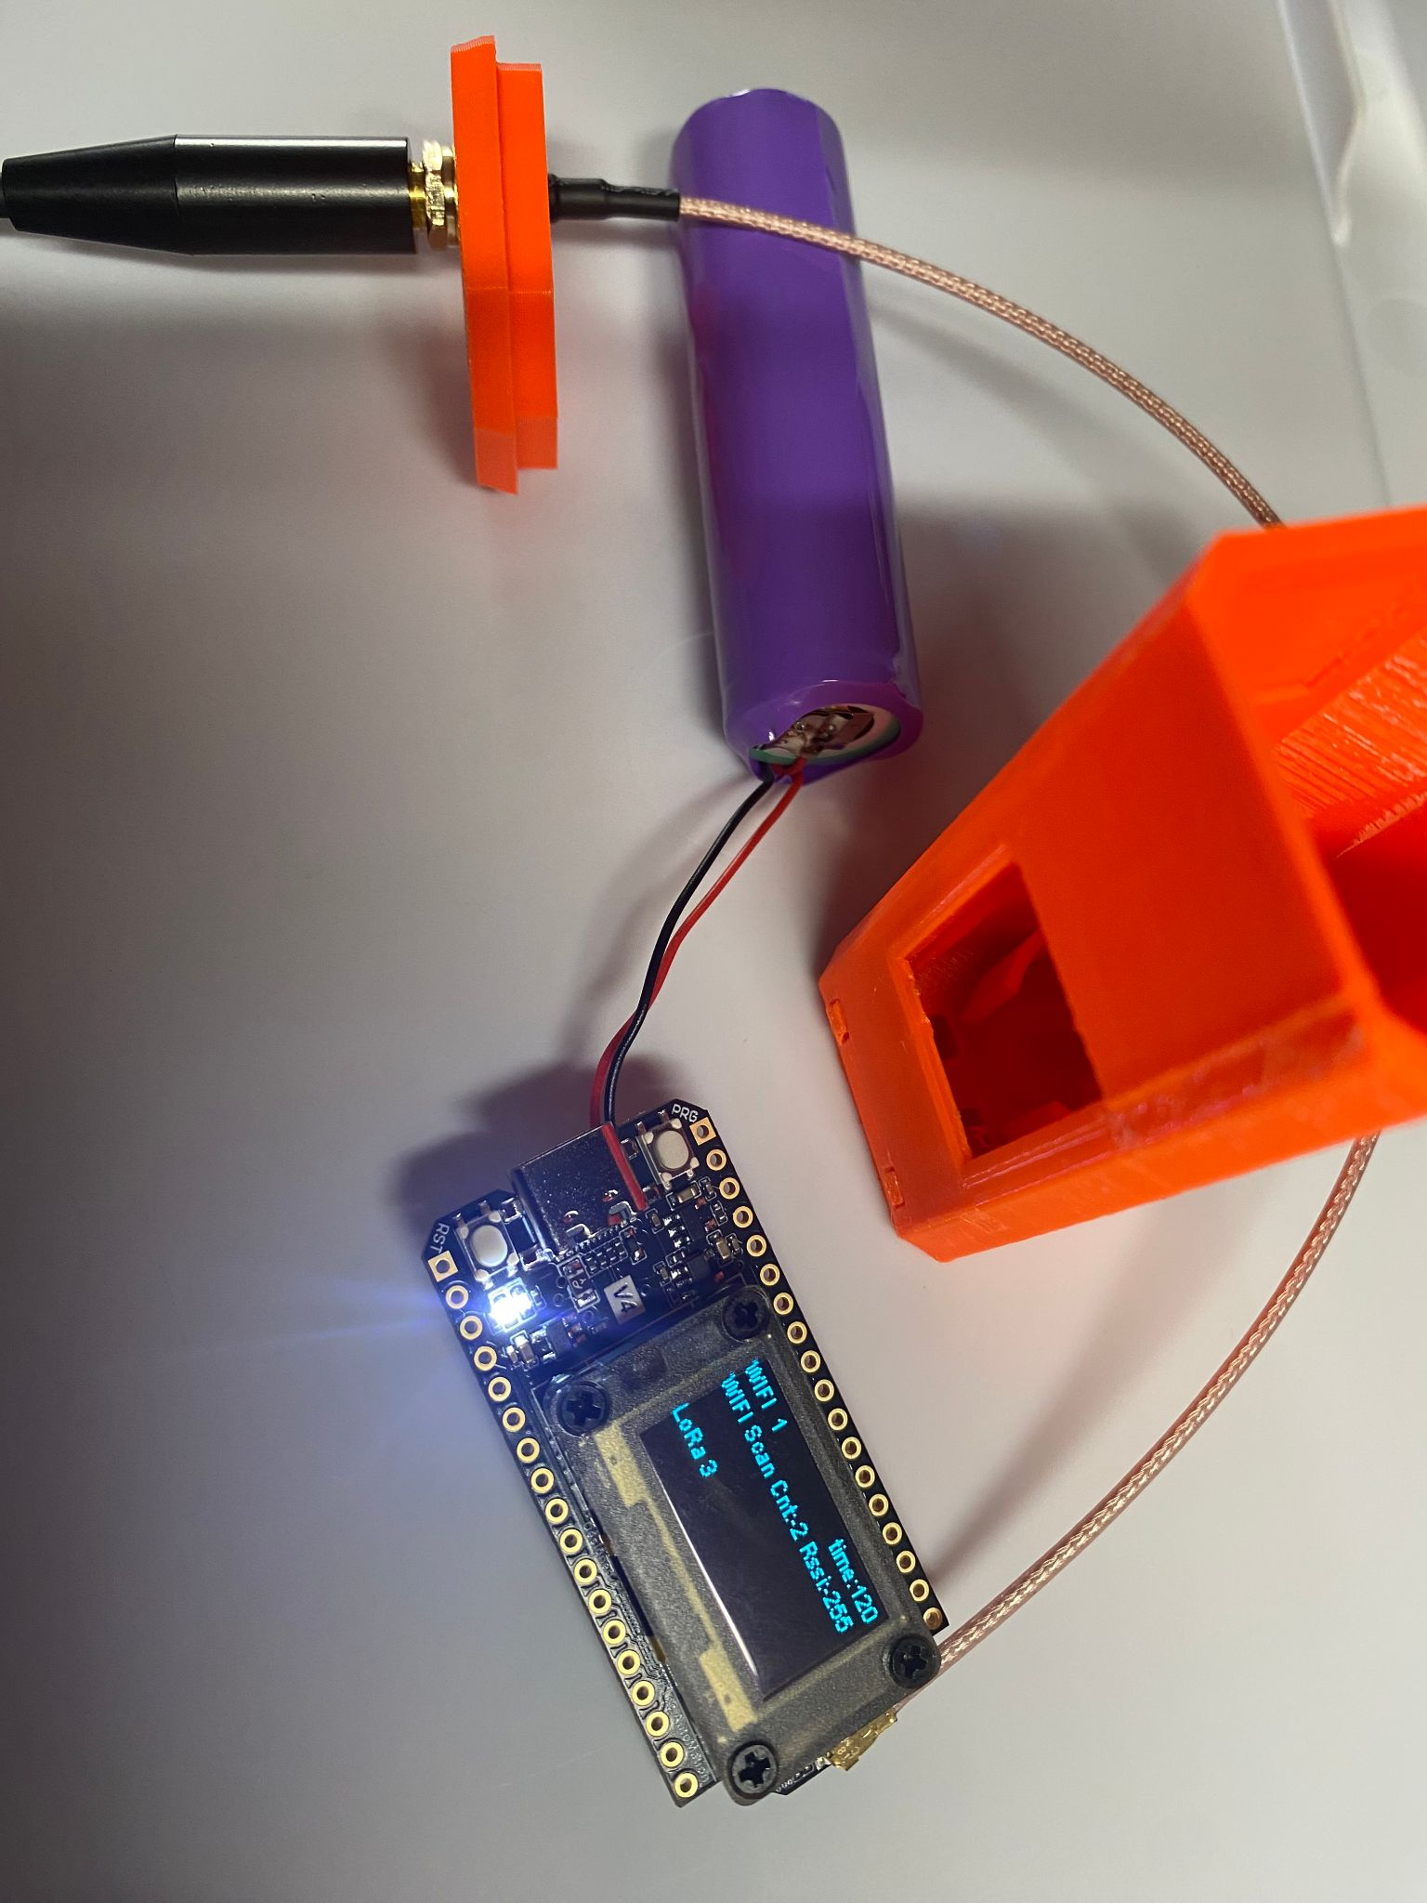
Power Supply and Case - Handheld Mobile Node
NOMADv1
$30 components
Heltec v4
GT-800 antenna
Battery pack
PETG case
Currently researching:
Building cheaper, better antennas at scale
  Hinged? (best performance when antenna vertical)
FakeTec boards
Lid pops off case in current model

Slide 20
Questions?

Slide 21

Meshtastic Configuration
Grey Fox

Slide 22
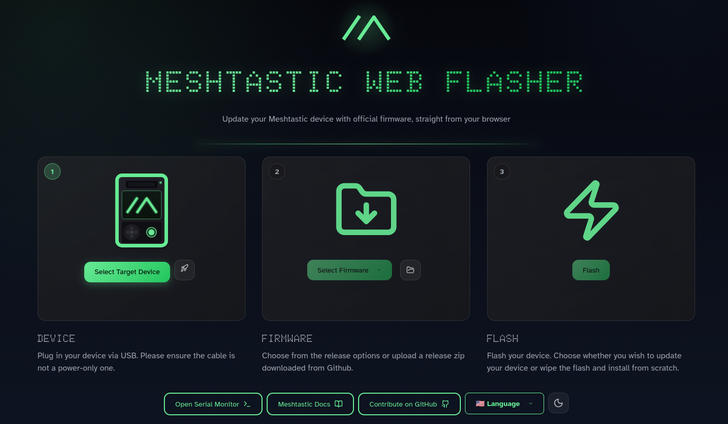
Flashing Firmware
https://flasher.meshtastic.org/
Requires Chromium-based browser

Slide 23
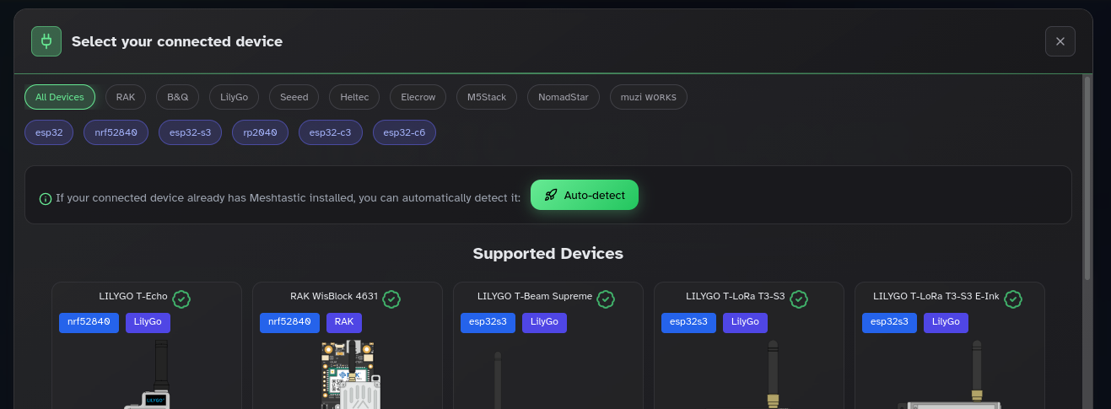
Selecting Target

Slide 24
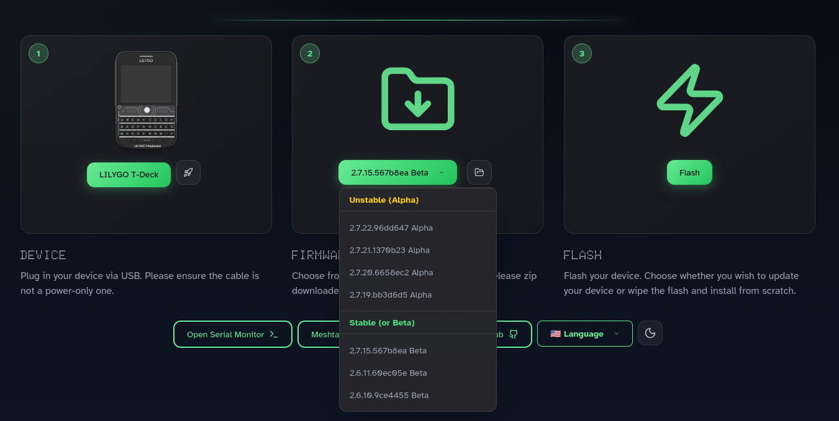
Firmware Version

Slide 25
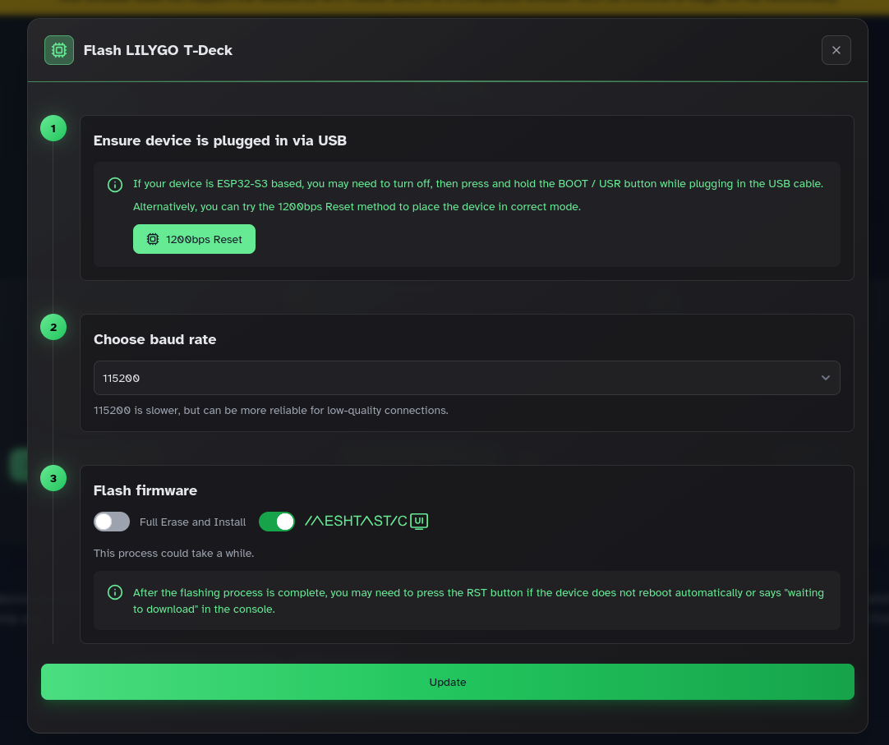
Firmware Version
Boot mode is not the same for all devices
nRF62840 usually auto-switches to bootloader
Some devices require manual file upload
USB cable is likely the issue
Some GNU/Linux distros won’t play ball

Slide 26
Baseline Configuration
Meshtastic mobile app + BLE tether
LoRa
Region: United States
Presets: LONG_FAST
Number of Hops: 6 (depends on node density)
User
Long Name: dealer’s choice
Short Name: 4 characters
Licensed Amateur: HAM operators have a reserved space – no encryption allowed

Slide 27
Device Role
Device
Device Role: CLIENT
Rebroadcast Mode: ALL
Client | Send and receive all
Client Mute | No routing or repeating
Client Base | Favorite nodes get priority—rooftop choice
Client Hidden | Send and receive only user-designated channels
Router/Repeater | Always rebroadcasts, never originates, no deferment
Router Late | Like router, but defers to concurrent routing
Sensor | Telemetry over text messaging
Tracker | Tracking tag

Slide 28
More Configuration
Position: user’s choice
Power: important for Sensor, Tracker
Display: nice-to-have options; keep default
Bluetooth: no-screen devices have default PINs
  0000
  1234
  123456
Consider changing them

Slide 29
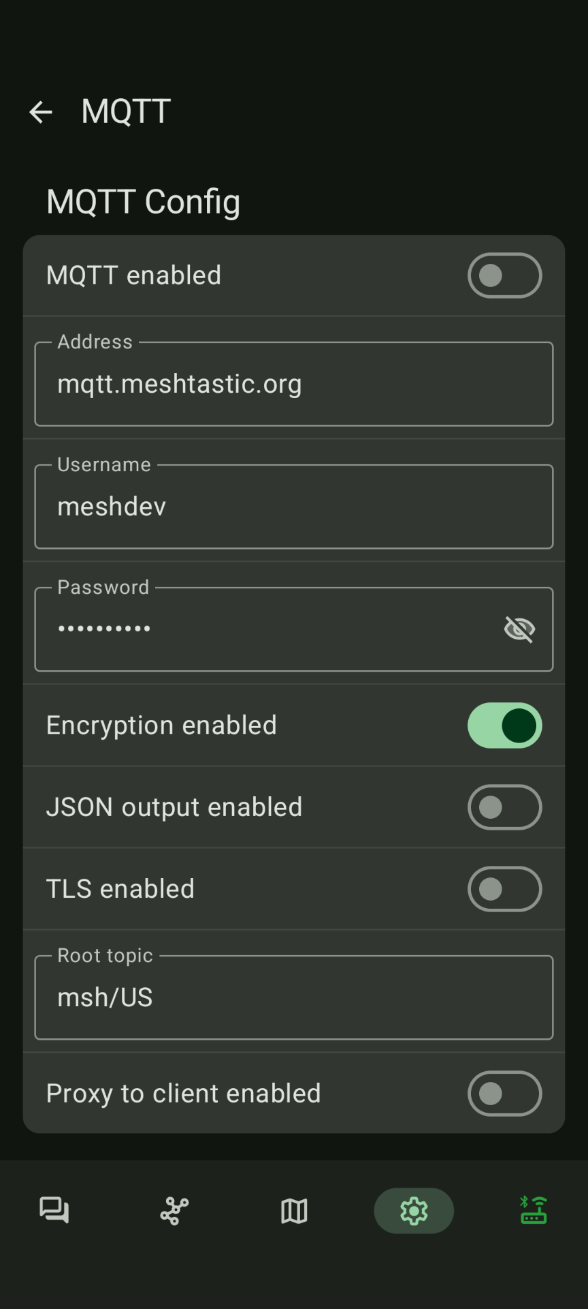
Module Configuration
MQTT: it depends
  Default: https://mqtt.meshtastic.org/
  Consider: https://mqtt.wpamesh.net/
Serial: computer tethering options
External Notification: LED, buzz, and vibrate
Store & Forward: if acting as a server, enables infrastructure for message control
  Only ESP32 based devices with onboard PSRAM like the T-Beam and T3-S3 can be a Store & Forward Server.

Slide 30
Useful App Stuff
Nodes Tab
  Mark favourites
  Check hardware
  Send a direct message
Mesh Map: only if GPS enabled
NodeDB Reset: empties recorded nodes, starts over
Traceroute: doesn’t always work, but gives good awareness of routing and hops

Slide 31
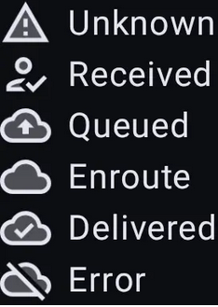
Messaging
Direct message received and acknowledged
Waiting for your node to connect
Waiting for a node receive/ack it
Message received by mesh
No network or hop/rebroadcast limit exceeded

Slide 32
Channels
Settings > Channels
Key auto-generated based on name
Limit 7 channels
LongFast is default primary channel
  Changing Primary forces manual frequency slot configuration
Uplink/Downlink: allows send/receive from public internet gateway
  Gateway configured in MQTT settings
Position: shares location if active

Slide 33
Questions?

Slide 34
THANK YOU!
THANK YOU!

